Slide 1



Spoke-Darts for High-Dimensional Blue-Noise Sampling
Scott A. Mitchell ACM TOG 37:2, May 2018 Scott A. Mitchell, Mohamed S. Ebeida, Muhammad A. Awad, Chonhyon Park, Anjul Patney, Ahmad A. Rushdi, Laura P. Swiler, Dinesh Manocha (now UMD), Li-Yi Wei
SIGGRAPH 2018 18 minutes talk 15 Aug 10:45 am session talk 4 West Building, Room 109-110
Notes:
Scott Mitchell
Title
From CCR
Thank partners, especially Li-Yi

Slide 2
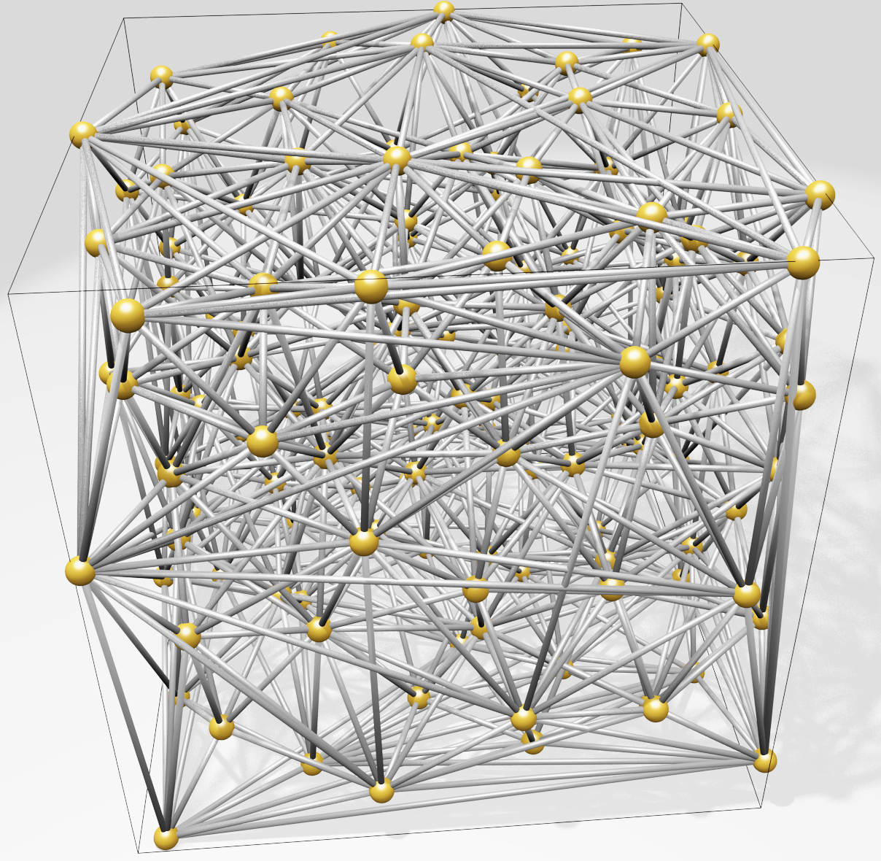
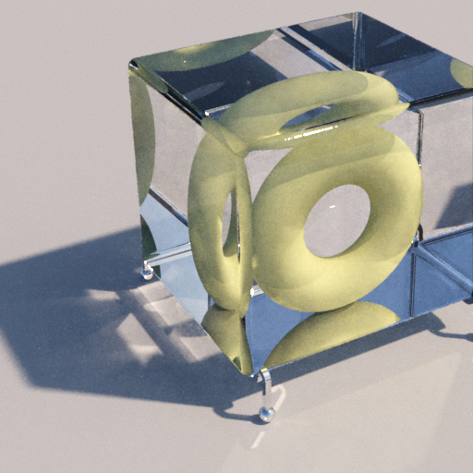
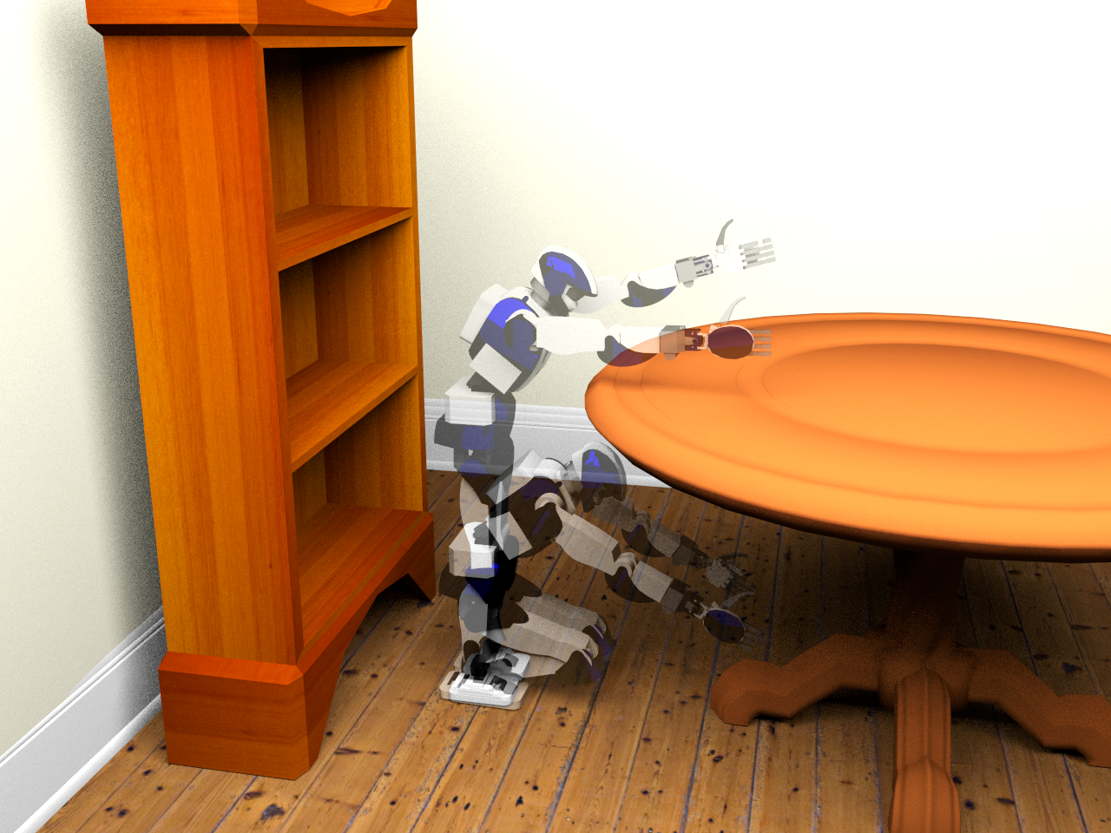
Motivation
High-dimensional blue-noise sampling is useful but hard to generate
Render
Geometry
8-100D: approximate Delaunay Graphs (Voronoi neighbors)
8D: proof-of-concept path tracing
Social proof of utility: Bridson SIGGRAPH 2007 cited 200 times
23D: find a path in robot configuration space
Motion Plan
Optimize
100D: adaptively explore black-box function to find global minimum
Notes:
why would you want high-d blue noise?
in paper, demo apps ...
evidence or relevance I'm most interested in is attention given to prior solution, 1 page SIGGRAPH sketch 10 years ago
clear improvement : discovered output flaws, fixed, and provided guarantees

Slide 3
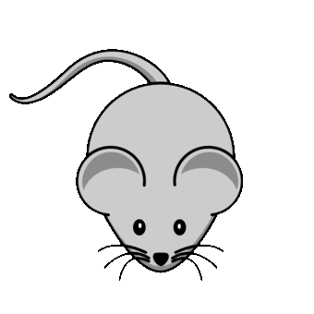

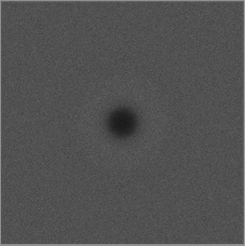
Motivation
Maximum
domain-to-sample distance
Goal: algorithm to produce point distributions
Requirements
Output: blue-noise, uniform-random point distribution except
No points too close
No big gaps
Algorithm
Memory & time scales to high dimensions (e.g. 20D)
Locally adaptive, general domain shapes
Confidence: provable guarantees on output quality
Goal: algorithm to produce point distributions
Requirements
Output: blue-noise, uniform-random except
No points too close
No big gaps
Process
Memory & time scales well to high dimensions (e.g. 20D)
Locally adaptive, general domain shapes
Confidence: provable guarantees on output quality
Goal: algorithm to produce point distributions
Requirements
Output: blue-noise, uniform-random point except
No points too close
No big gaps
Process
Memory & time scales well to high dimensions (e.g. 20D)
Locally adaptive, general domain shapes
Confidence: provable output quality
Goal: algorithm to produce point distributions
Requirements
Output: blue-noise, uniform-random point distribution except
No points too close
No big gaps
Process
Memory & time scales well to high dimensions (e.g. 20D)
Locally adaptive, general domain shapes
Confidence: provable guarantees on output quality
Minimum sample separation
RP Radial Power
RDF Radial Distance Function
Notes:
What exactly are we trying to produce?

Slide 4
What’s wrong with the algorithms we already have?
SimpleMPS guarantees saturation
runtime & memory
divide domain into cubes while ∃cubes, and cube diagonal > machine precision do (A(d) × #cubes) times: pick a cube pick sample from cube if distance(sample, prior samples) > r accept sample discard cube refine cubes discard covered cubes
darts
refine
darts
refine
SimpleMPS, “A Simple Algorithm for Maximal Poisson-Disk Sampling in High Dimensions,” Eurographics 2012.
Notes:
simple mps
saturation
runtime
describe algorithm
what's not to love?

Slide 5
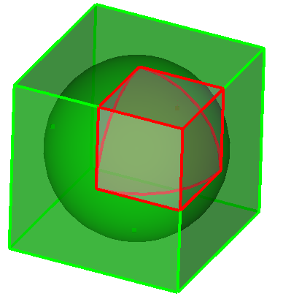
What’s wrong with the algorithms we already have?
SimpleMPS guarantees saturation … but doesn’t scale by dimension, d. ☹
runtime & memory
Problem: cube poorly approximates sphere Exponentially worse as dimension increases More empty boxes, memory limit d≈6
darts
…
refine
d=1
V(cube) = 1
V(sphere) = 1
d=2
V(cube) = 1
V(sphere) = 0.785…
d=3
V(cube) = 1
V(sphere) = 0.523…
d→∞
V(c) = 1
V(s) → 0
darts
Any algorithm that constructs (an approximation of) remaining sample space is doomed to be exponential-in-d
refine
SimpleMPS, “A Simple Algorithm for Maximal Poisson-Disk Sampling in High Dimensions,” Eurographics 2012.
Notes:
doesn't scale with dimension
vanishingly poor time and memory as d increases

Slide 6
What’s wrong with the algorithms we already have?
Bridson 2007* scales
runtime & memory
do prior = randomly pop Front do pick sample from volume of (r,2r) annulus of prior if distance(sample, all samples) > r accept sample add sample to Front until 30 consecutive rejections until Front is empty
Bridson 2007* pseudocode
30+ depending on dimension
*Modified: no background grid, no exponential-in-d complexity.
Bridson 2007, "Fast Poisson disk sampling in arbitrary dimensions." SIGGRAPH '07 sketch.
Notes:
Here's one that scales
<click> to start animation
describe alg while animating

Slide 7
What’s wrong with the algorithms we already have?
Bridson 2007* scales … but doesn’t guarantee saturation ☹
runtime & memory
Trivial in one annulus
Unknown outside all annuli?
?
Bridson 2007, "Fast Poisson disk sampling in arbitrary dimensions." SIGGRAPH '07 sketch.
Notes:
no saturation guarantee

Slide 8
Proposed Spoke-Darts algorithm
Spoke-Darts scales
runtime & memory
do prior = randomly pop Front do pick sample from radial line through (r,2r) annulus of prior if distance(sample, all samples) > r accept sample add sample to Front until 12 consecutive rejections until Front is empty
Spoke-Darts mod from Bridson
O
12 same for all dimensions
Spoke-Darts for High-Dimensional Blue-Noise Sampling, TOG 72:2, SIGGRAPH 2018.
Notes:
Our solution is to replace point samples with line samples
<click> to start animation
anchor point
<click> continue

Slide 9
Proposed Spoke-Darts algorithm
Spoke-Darts scales … and guarantees saturation ☺
runtime & memory
Proved probabilistic bound outside all annuli!
!
Spoke-Darts for High-Dimensional Blue-Noise Sampling, TOG 72:2, SIGGRAPH 2018.
Notes:
enables proof of saturation

Slide 10
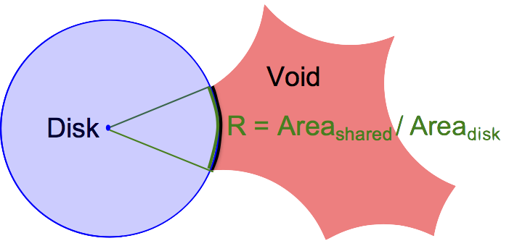
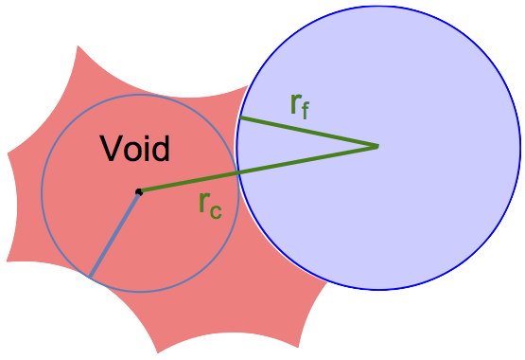
Suppose there exists a void
Proof of saturation
Spoke-Darts scales … and guarantees saturation
One disk
Missed 12 times, so area R is probably small, Probability of 12 misses = 𝝥(1-R) = (1-R)¹² < e^{(-12R)}
All disks Probability all missed = product of probabilities
p = 𝚷 e^{(-12 R_i)} = e^{-12 𝚺 R_i} so unlikely that the total surface area is large
Small surface area → small void radius
No big gaps!
Notes:
proof sketch
consider void...
<click>
one disk touching void
<click>
all bounding disks - areas add up to still be small
<click>
small surface area -> small radius

Slide 11
Structure of saturation guarantee
Magic values for dimensional independence
e.g.
e.g.
where
chance beta exceeded
#misses, failed darts
dimension
pick any three
Notes:
Structure of our guarantee
Beta ratio of distances we talked about, domain pt to sample, sample to sample
m alg param
<click>
eps and m in proper ratio -> dimensional independence
<click>
Magic value is to pick m and epsilon in proper ratio so circle quantity is 1, raised to some power depending on d
m=12 works in paper
m=30, would take 3x longer, provide vanishingly small probability of large gaps

Slide 12
Output Saturation in Practice
Output Saturation in Practice,= better than Bridson
Bridson
one dimension “for free”
Theory: Beta = constant
Practice: Beta increases and narrows with d
Narrowing consistent with theory
Spoke-Darts
Spoke-Darts
dimension = 2
3
4
5
6
Bridson
Notes:
In theory beta is a constant
In practice it creeps up; we don’t now what it does in higher d because the algs to compute beta don’t scale
Narrows – more sophisticated theory analysis predicts
<click>
better saturation than bridson, about same as one dimension lower

Slide 13
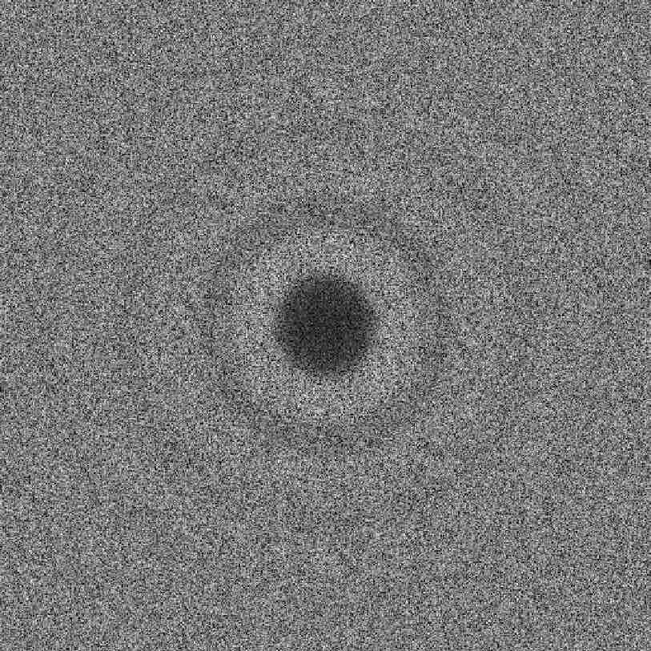
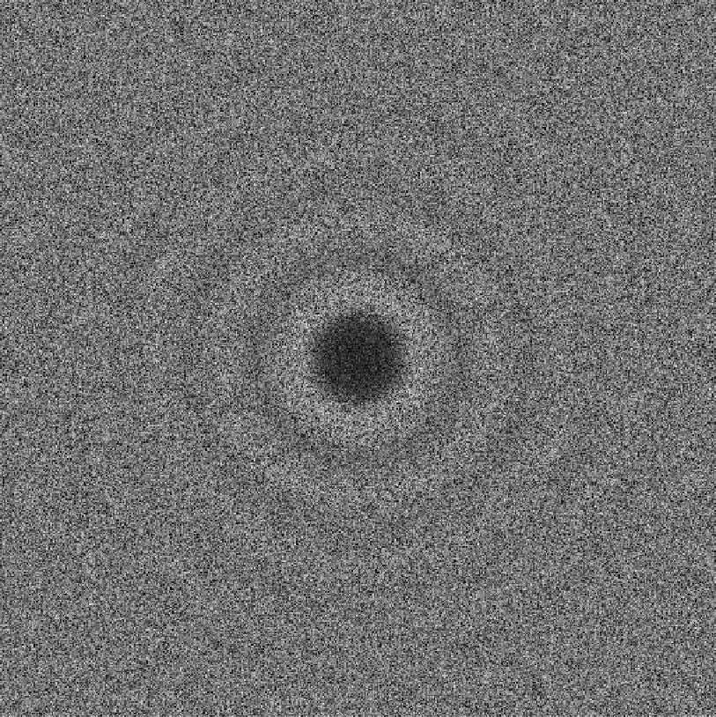
Output Randomness – Blue noise
Sharp spike at radius! (annuli inner-radius)
d=2
Dart Throwing
Spoke-Darts
Pairwise distances between samples
Bridson 2007
2nd discontinuity annuli outer-radius
RDF distances
Dart throwing images from
Blue Noise Sampling with Controlled Aliasing, TOG 32:3, 2013.
Fourier Transform, 1d integral over angle by radius
Fourier Transform
Notes:
Typical way to evaluate blue noise
rdf - explain
rp
spectrum
<click>
what in the world is this? They all have this spike. many more points are exactly r apart than you would expect from chance
Why would anyone want that? Historical?
Appears to be fundamental price for trying to achieve B=1
<click>
top it off, Bridson has a *second* discontinuity
yuck.

Slide 14
Output Randomness – Blue noise
Eliminate spike
Post-processing optimization* = expensive, 2d
Sample non-uniformly
By spoke-length? Uniform by swept volume? Worse!
Any sharp local rule → global discontinuity ☹
Spoke-Darts
RDF distances
Good idea
r_{cover} max domain-point-to-sample distance
r_{free} min sample-to-sample distance
Bad idea
r_{free} = r_{cover} ⟺ 𝜝=1
Traditional goal of Maximal Poisson-disk Sampling!
Serves no purpose
RP frequency
frequency
* Blue Noise Sampling with Controlled Aliasing, TOG 32:3, 2013.
Notes:
surely we can do better
I experimented with non-uniform sampling along spokes, but everything I tried just made it worse!
<click>
let me be controversial for a moment
Rfree, rcover both good ideas
Setting them the same is a bad idea

Slide 15
Output Randomness – Blue noise
Eliminate spike – we solved in 2012 ☺
† Two-radii : r_{free} ≠ r_{cover}
Small blue r_{free} minimum sample separation
Large green r_{cover} maximum domain-to-sample
Unique coverage: accept only if covers white
Two-spokes mimic Two-radii
1st spoke, trim by large green
2nd spoke, trim by small blue
Spoke-Darts
RDF distances
accept, green covers some white
RP frequency
reject, inside a blue disk
reject, green already covered
frequency
† Variable Radii Poisson-Disk Sampling, Canadian Conf. on Comp. Geometry (CCCG) 2012.
Notes:
Actually I already fixed the spike 6 years ago
but let me remind the Graphics Community
Idea is to have two radii around each point. This is *not* the annulus from before
<click to appear and disappear each case>
Still reject if points are too close
New- reject if large green disk doesn’t add anything to coverage
This third one is OK
This can be implemented using SimpleMPS
<click>
new solution for high-d = use two spokes to mimic the two radii
<click> each step of first pair of spokes
temp sample S
*second* spoke +/-2(rfree - rcover)
<click and just watch animation>

Slide 16
Output Randomness – Blue noise
Eliminate spike
† Two-radii : r_{free} ≠ r_{cover}
Small blue r_{free} minimum sample separation
Large green r_{cover} maximum domain-to-sample
Unique coverage: accept only if covers white
Two-spokes mimic Two-radii
1st spoke, trim by large green
2nd spoke, trim by small blue
Spoke-Darts
RDF distances
† Variable Radii Poisson-Disk Sampling, CCCG 2012.

Slide 17
Output Randomness – Blue noise
Eliminate spike
† Two-radii : r_{free} ≠ r_{cover}
Small blue r_{free} minimum sample separation
Large green r_{cover} maximum domain-to-sample
Unique coverage: accept only if covers white
Two-spokes mimic Two-radii
1st spoke, trim by large green
2nd spoke, trim by small blue
Spoke-Darts
RDF distances
† Variable Radii Poisson-Disk Sampling, CCCG 2012.

Slide 18
Output Randomness – Blue noise
Eliminate spike
† Two-radii : r_{free} ≠ r_{cover}
Small blue r_{free} minimum sample separation
Large green r_{cover} maximum domain-to-sample
Unique coverage: accept only if covers white
Two-spokes mimic Two-radii
1st spoke, trim by large green
2nd spoke, trim by small blue
Spoke-Darts
RDF distances
† Variable Radii Poisson-Disk Sampling, CCCG 2012.

Slide 19
Output Randomness – Blue noise
Eliminate spike
† Two-radii : r_{free} ≠ r_{cover}
Small blue r_{free} minimum sample separation
Large green r_{cover} maximum domain-to-sample
Unique coverage: accept only if covers white
Two-spokes mimic Two-radii
1st spoke, trim by large green
2nd spoke, trim by small blue
Spoke-Darts
RDF distances
† Variable Radii Poisson-Disk Sampling, CCCG 2012.

Slide 20
Output Randomness – Blue noise
Eliminate spike
† Two-radii : r_{free} ≠ r_{cover}
Small blue r_{free} minimum sample separation
Large green r_{cover} maximum domain-to-sample
Unique coverage: accept only if covers white
Two-spokes mimic Two-radii
1st spoke, trim by large green
2nd spoke, trim by small blue
Spoke-Darts
RDF distances
† Variable Radii Poisson-Disk Sampling, CCCG 2012.

Slide 21
Output Randomness – Blue noise
Eliminate spike
† Two-radii : r_{free} ≠ r_{cover}
Small blue r_{free} minimum sample separation
Large green r_{cover} maximum domain-to-sample
Unique coverage: accept only if covers white
Two-spokes mimic Two-radii
1st spoke, trim by large green
2nd spoke, trim by small blue
Spoke-Darts
RDF distances
† Variable Radii Poisson-Disk Sampling, CCCG 2012.
Notes:
Stop as before after 12 misses

Slide 22
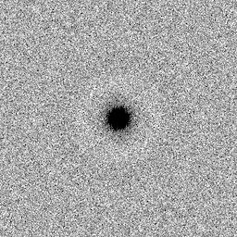
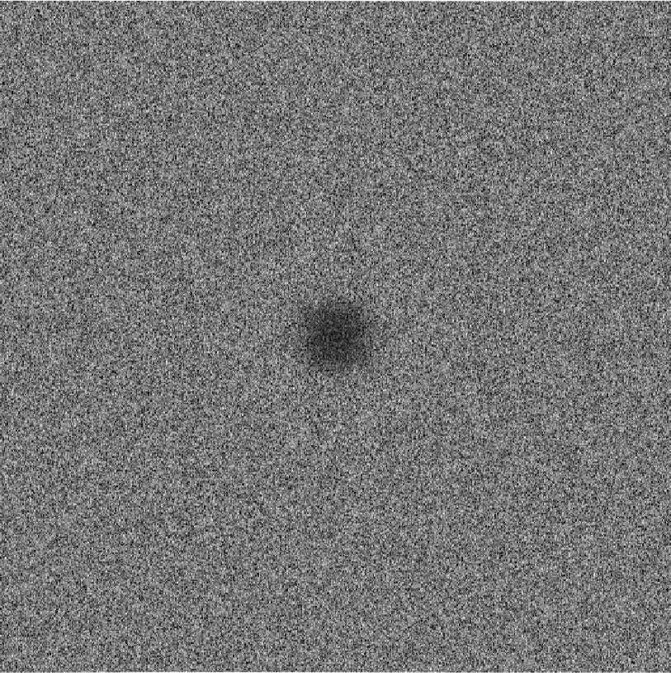
Output Randomness – Blue noise
Flat spectrum no spikes
d=2
MPS (One-Radii)
Two-Spokes
Two-Radii
Spoke-Darts
Eliminate spike: solved 2012 for low-d
Eliminate spike: solved 2018 for high-d
RDF distances
Pairwise distances between samples
RDF distances
Fourier Transform, 1d integral over angle by radius
RP frequency
RP frequency
Fourier Transform
frequency
frequency
Notes:
What does this get you?
no more spike
no more oscillations
very faint light ring around dark center
I don’t want to see anymore spikes in TOG papers.
We’ve known how to avoid it in low-d since my paper six years ago. Now we know how in high-d.
Spike is not needed, waste of samples, ruins randomness
Cost is 2x factor in saturation. Small price to pay.

Slide 23
Application: Approximate Delaunay Graph
Trim line-spokes to find “significant” neighbors in Voronoi diagram
New graph edge to
significant neighbor
3d rendering of 8d graph
Notes:
Application building an approximate Delaunay graph
<Go fast, not interesting>
Shoot a random spoke
Trim it by separating hyperplanes
Remember the point that trimmed it the most
Add a Delaunay edge to it

Slide 24
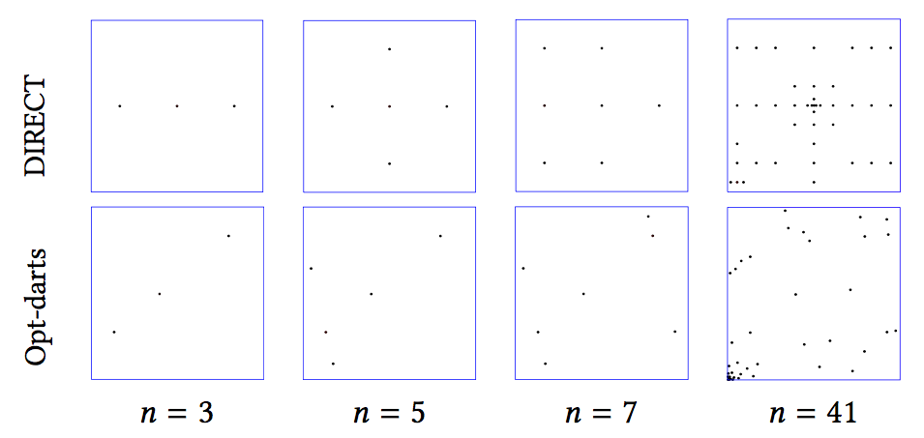
Application: Global Optimization
DIRECT = DIviding RECTangles
Divide space by rectangles
Refine large rectangles with small sample values
Opt-Darts
Divide space by Voronoi cells (implicit only)
Refine large cells with small sample values
Approx. Delaunay graph defines “large” cells
Spoke-darts selects refinement sample
Opt-Darts: 5-25× speedup over DIRECT
Increasing speedup with d
Rectangle bad approximation of Voronoi cell
More-random sample patterns
Notes:
We use that approximate Delaunay graph in a global optimization algorithm that is a variant of DIRECT
We replace dividing rectangles with dividing Voronoi cells, using spokes a second time to decide how to divide them
Get a large speedup, even larger as the dimension increase
Remember what I said about cubes poorly representing uniform distances as the dimension gets bigger

Slide 25
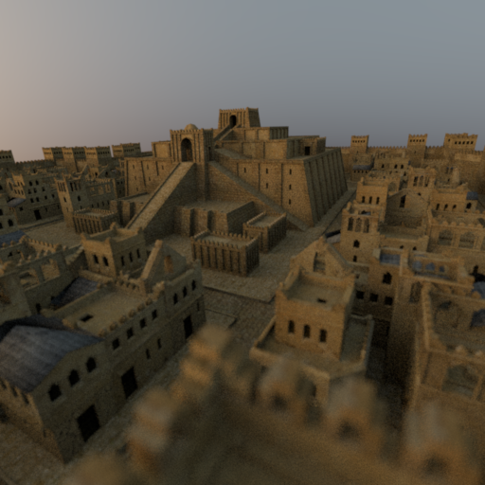

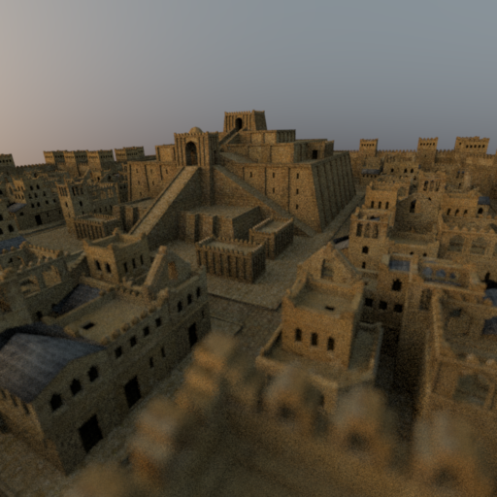
Application: Rendering
Mitsuba ray tracing
4D = 2 screen × 2 lens
16 samples per pixel
Spoke-darts comparable to alternatives
Stratified
Low discrepancy
Notes:
We do high dimensional rendering
Not any better than the alternatives, but not worse

Slide 26
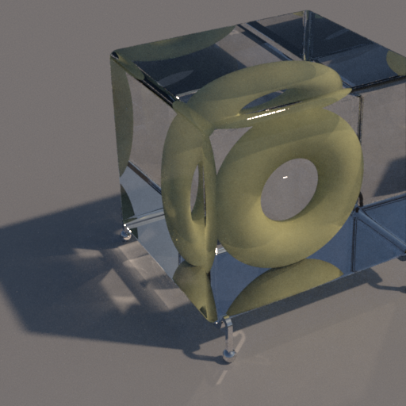
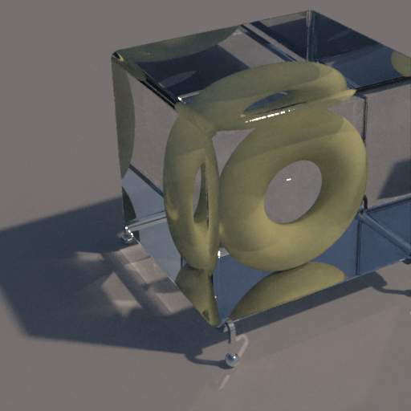

Application: Rendering
Mitsuba ray tracing
8D = 2 sky-emitter × 2 screen × 2 × 2 bounce
256 samples per pixel
Spoke-darts comparable to alternatives
Stratified
Low discrepancy
Notes:
Here’s 8d ray shooting

Slide 27
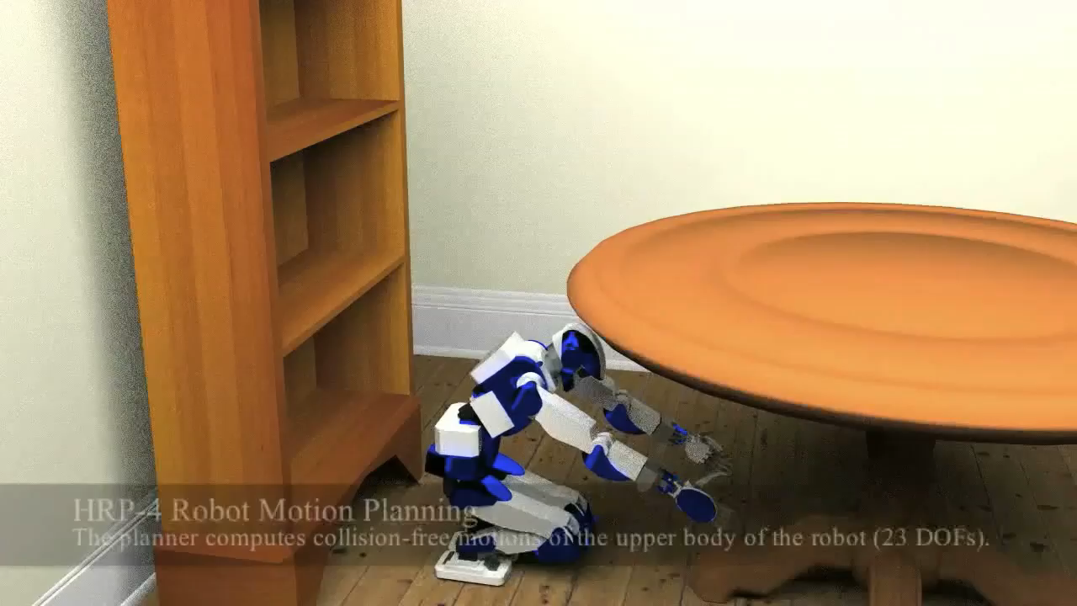
Application: Motion Planning
Path = robot: under table to up book: table to shelf
23d = degree of freedom robot
Non-uniform: joint angles and room dimensions
Pre-sample configuration space with spoke-darts
Explore paths in parallel, avoid redundant searches
Order of magnitude speedup
Notes:
We also did spoke-darts sampling of high dimensional configuration space for robot motion planning.
Pre-sampling allows the exploration of many paths in parallel, while avoiding redundant searches.

Slide 28

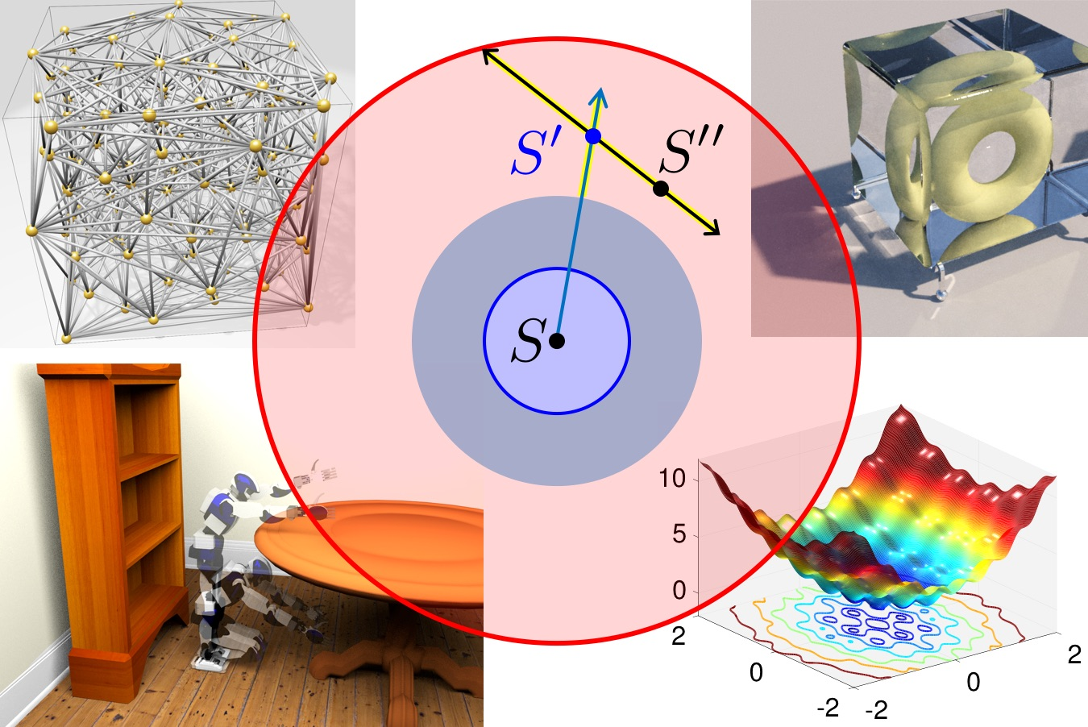
Conclusions
Open problems
Faster than O(d n² ) time?
Our experiments had r_{cover} = 2 r_{free}
Spectrum effects for other ratios?
Prove non-trivial saturation-bound on Bridson 2007?
Does saturation matter for high-d rendering, other “Graphics” applications ?
Free software
SpokeDartsPublic on github https://github.com/samitch/SpokeDartsPublic
Recommendations Two-radii Quality blue-noise in d < 5
Spoke-Darts Blue-noise d ≥ 5 Linear scaling by dimension Guaranteed saturation
Geometry
Render
Two-Spokes
Better spectrum: no spike New standard for quality blue noise
Optimize
Motion Plan
Notes:
I've made the software available for free
In conclusion, my guidance is to
use two-radii for low dimensional blue noise,
spoke-darts in high dimensions
two-spokes if you better quality noise
Open problems
is faster than d n^2 possible? Bottle neck is finding neighbors
what's the effect of using different ratios of radii?
prove something about saturation for bridson?
does saturation matter for rendering or other traditional graphics applications
Thank you.
questions?

Slide 29
Backup slides
Spoke-Darts

Slide 30
Runtime , best one can hope for
d
Linear scaling is perfect: primitives are O(d)
n²
Finding neighbors in high dimensions expensive
Each of n samples, find neighbors
Each of n may have n neighbors
Finding them quickly still won’t prevent n²
Spoke-Darts ≈ Bridson 2007 due to simple primitives
Is point in sphere
Trim segment by sphere
Runtime( Two-Spokes ) > Runtime( One-Spoke )
mostly due to 2 × radius of annulus, many more neighbor disks
Notes:
d perfect
n^2 : find if you can do neighbor finding better than brute force in d=20 ... result!
but in high-d all the points are neighbors so n^2 best you can hope for
fast - simple primitives
two-spokes expensive from large search radius

Slide 31
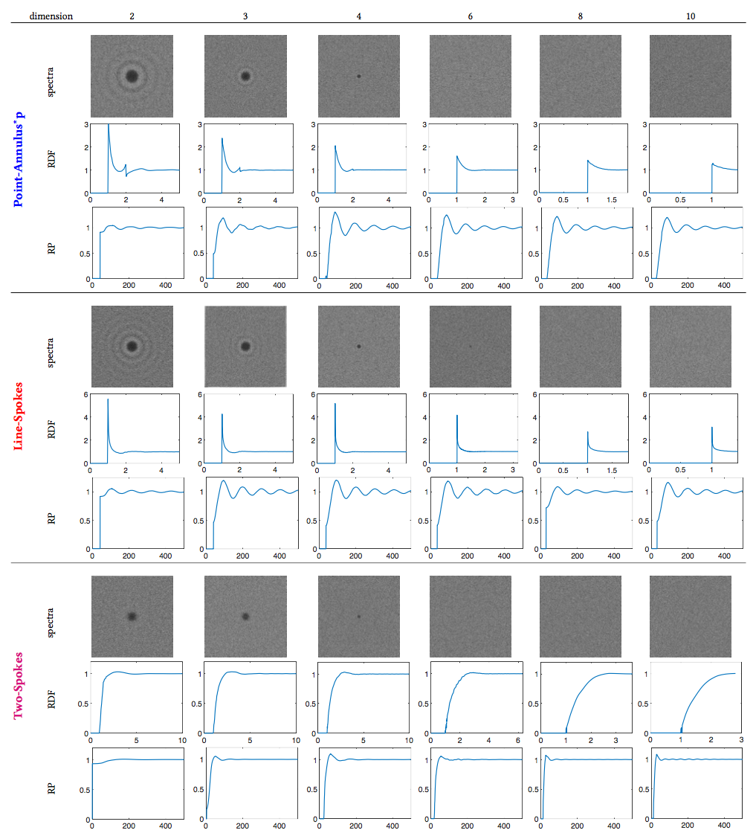
Spectra by dimension

